Slide 1
Exploring the IBM 5100
From the SCAMP prototype to the PALM instruction set
Steve Lewis
June 25th, 2023

Slide 2
Topics
PART 1: Review of IBM 5100-series systems
PART 2: Q&A with IBM 5100 pioneers
Examples of IBM 5110 users
CORE International
Aspects about the IBM 5110 BASIC implementation
PART 3: Evidence of the S/360 and S/3 mainframe relationship
How the 5100/5110 Executable ROS was extracted
How the PALM machine code was reverse engineered
Arrangement of Non-Executable segments
Exploring EBCDIC, Jump Table Vectors, PALM
PART 4: IBM 5100 News!
20min
20min
5min

Slide 3
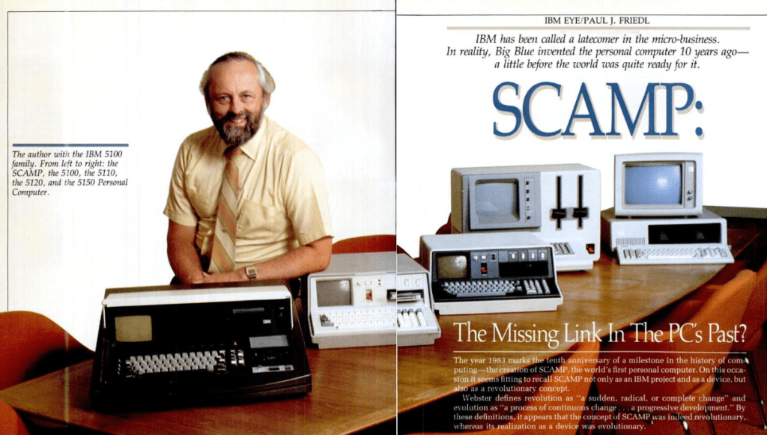
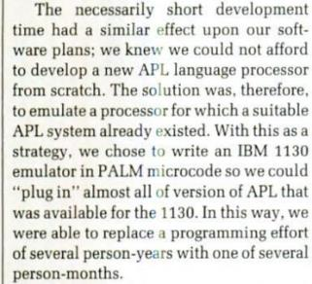

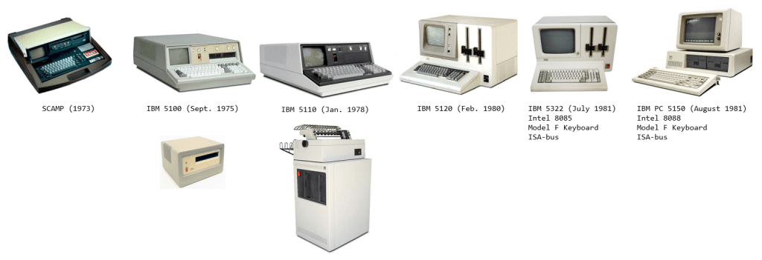
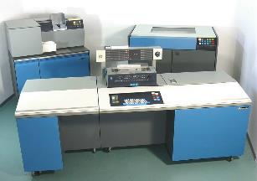
PC Magazine
November 1983
(Special Computer,
APL Machine Portable)
Datamaster/23
P.A.L.M.
8085
8088
(“x86”)
The IBM 5100 introduced the “big red power switch” also used in the IBM PC.
IBM 1130
Notes:
This slide should state the level & Learning Objective the audience should be at:
Today we are here to understand how to…, tools required, and gain the ability to…
Or
Today we are here to Dismantle, Rebuild, and install X…

Slide 4
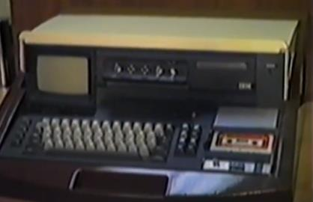
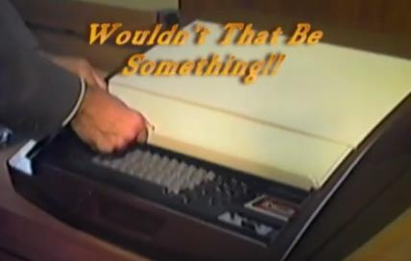
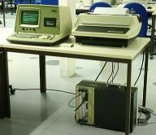
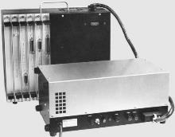
S.C.A.M.P. (Special Computer, APL Machine Portable)
YT: SCAMP 2013 by Friedl
https://www.wang2200.org/systems.html
In 2013, Alvin Ginsburg relayed stories
about the development of SCAMP.
SCAMP is currently on display on the first floor of the National Museum of American History.
c. 1973
Stuttgart Computer Museum, Germany
http://computermuseum.informatik.uni-stuttgart.de/dev/wang2200s/
Notes:
This slide should state the level & Learning Objective the audience should be at:
Today we are here to understand how to…, tools required, and gain the ability to…
Or
Today we are here to Dismantle, Rebuild, and install X…

Slide 5
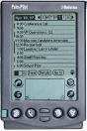
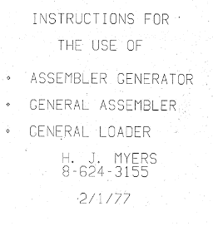
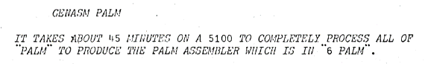
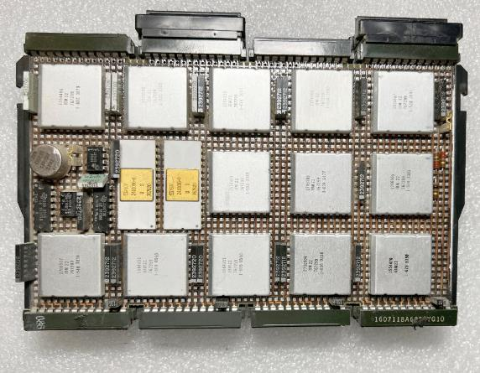
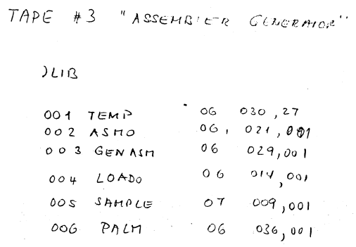
P.A.L.M. Put All Logic in Microcode
Not the 1990s PALM Pilot!
Internal IBM document.
“GENASM” (General Assembler)
The two “microprocessor” looking chips are each 64-byte Register Files.

Slide 6
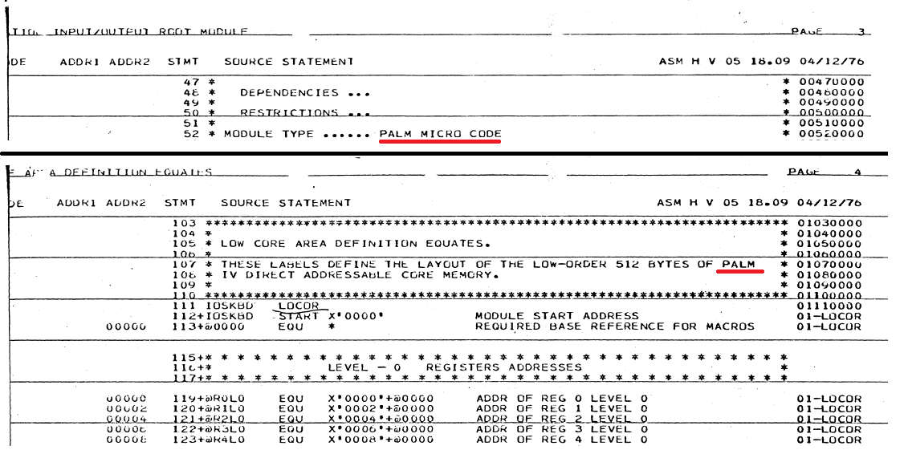
PALM Reference – 1976 (equates.pdf)

Slide 7
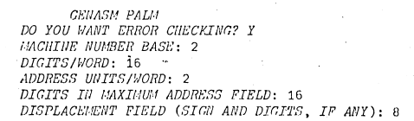
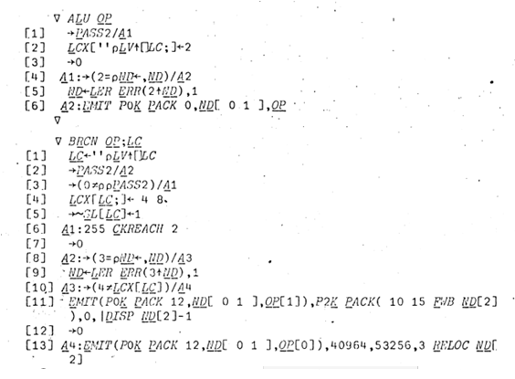
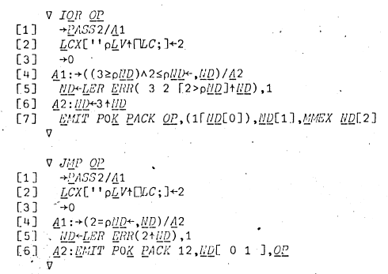
IBM Assembler Generator

Slide 8
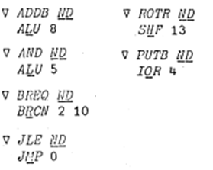
IBM Assembler Generator
12 APL functions defined and used to provide ~60 PALM assembler mnemonics
PALM

Slide 9
Some Q&A w/ Industry Pioneers
Dennis Roberson
Lead engineer for the IBM 5100
Hal Prewitt
Founder of CORE International

Slide 10
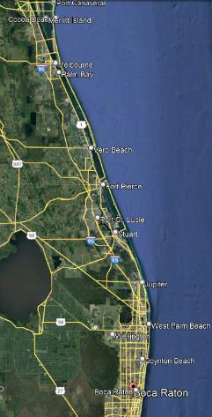
Dennis Roberson Q&A 1/3
Q: What do you recall on the development of the PALM processor?
A: PALM was developed by IBM's General Systems Division (GSD) Laboratory in Boca Raton, Florida (S/7, S/1, IBM PC)
“Development was under the leadership of Roger Abernathy with Bob Tuttle and Virgil Wyatt”
“it was the processor for the early prototype system that is now in the Smithsonian.”
“was intended for use in industrial application”
Dennis Roberson (M.S. E.E. Stanford)
Also highly involved in development of the SCAMP prototype.
“A Microprocessor-based portable computer: The IBM 5100” (IEEE Volume 64 issue 6, June 1976)

Slide 11
Dennis Roberson Q&A 1/3
Q: What do you recall on the development of the PALM processor?
A: …continued…
Paul Friedl asked Roy Harper (Los Gatos, CA) via Joe George on the “best” processor for a “portable” system, they recommended PALM.
“Joe George was the primary developer for the SCAMP electronics”
“Roy Harper developed the power supply”
w/ George Marenin, Ed Finnegan, Warren Christopherson
“Patrick Smith provided the software”

Slide 12
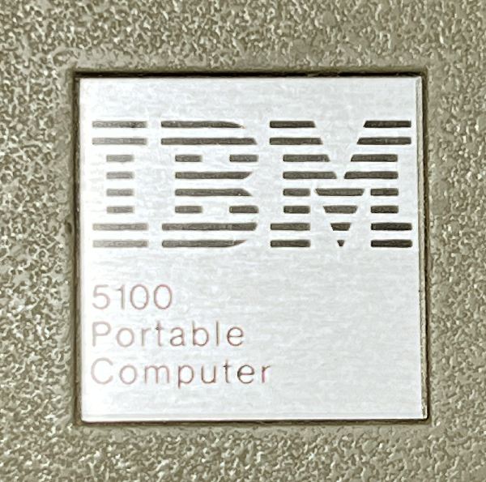
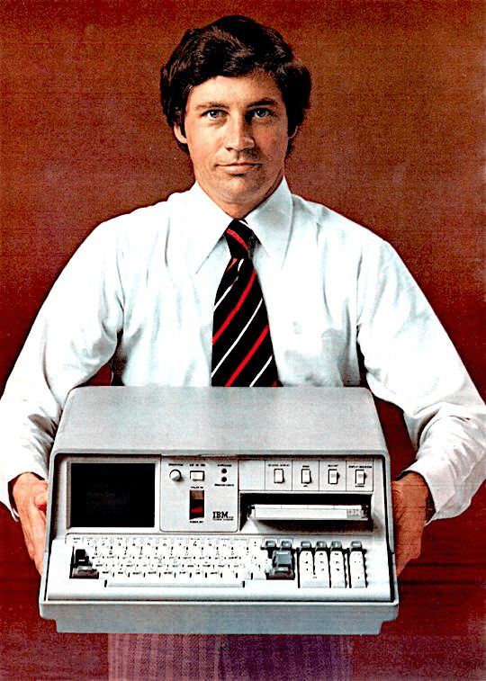
Dennis Roberson Q&A 2/3
Q: It has been suggested that PALM had some relationship to the Apollo program. Aside from scientists and universities, who else used the IBM 5100?
A: “While the NASA Apollo connection is possible, I don’t think the idea was ever consummated.” (the Boca Raton division was intended for industrial computers)
A: “The 5100 was indeed used by the DoD and in banking as well... They also had and have many needs aligned with problem solving and often in environments where ‘portability’ or more correctly size, weight and power consumption were important characteristics. It was used by other government agencies as well.”
IRS… CIA…

Slide 13
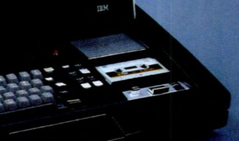
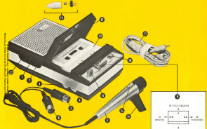
Dennis Roberson Q&A 3/3
Q: “Was the Norelco Carry-Corder in SCAMP functional?”
Known as Philips EL3300 in Europe (c.1963), available under Norelco brand in the US a year later (World’s First portable cassette recorder)
A: “The Norelco carry-coder was very much an operational part of SCAMP and did store the software that was regularly update. It was however very unreliable and every time we did a demo we usually loaded the software the night before and kept the system running over night for fear that the tape would not work at the wrong time.”

Slide 14
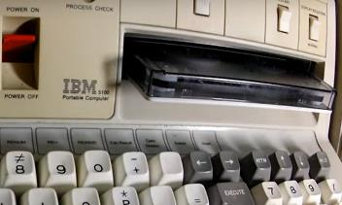
Dennis Roberson Q&A 3/3
Q: “Was the Norelco Carry-Corder in SCAMP functional?” (cont.)
Known as Philips EL3300 in Europe (c.1963), available under Norelco brand in the US a year later (World’s First portable cassette recorder)
“The 3M Tape cassette (DC300) was everything the Norelco was not, i.e., it was very reliable, was much faster and had much higher capacity, yet it was still small enough to fit in a transportable box.”
“There was a strong push in Rochester, MN where the 5100 was developed to switch to a floppy disk as the storage media. Unfortunately, floppy disks had an 8” format at the time and would have eliminated the notion of portability we were trying to get to with the 5100.”

Slide 15
Hal Prewitt Q&A (CORE)
Q: Do you know of any CoreNET hardware that is still available?
A: “…there are copies of PC-51 but no CoreNet LAN or hardware remains available. The hardware was for 5110, 5120 and the original IBM PCs.”
NOTE: CORE was sold to SONY (Aiwa) in c. 1993.
The amount I came across was that it was sold for ~$5 million.

Slide 16
Hal Prewitt Q&A (CORE)
A: “CoreNET was our storage & network for the 5110/5120 systems. We wrote PALM assembler, linker and IO drivers. We engineered an interface card that connected to the 5110/20 cabling design. Build cables and assorted storage systems. Did not use Async, Comm or parallel card features.”
A: “The HDD interface inside our drive boxes used SASI (predecessor to SCSI). On the 5110/20 we loaded a driver from the floppy which provided access to the CoreNet and our HD drives. The 5110/20 could directly access its storage devices (tape & floppies) and our HD systems just by using new references for our storage devices.”
e.g. D08 instead of D80

Slide 17
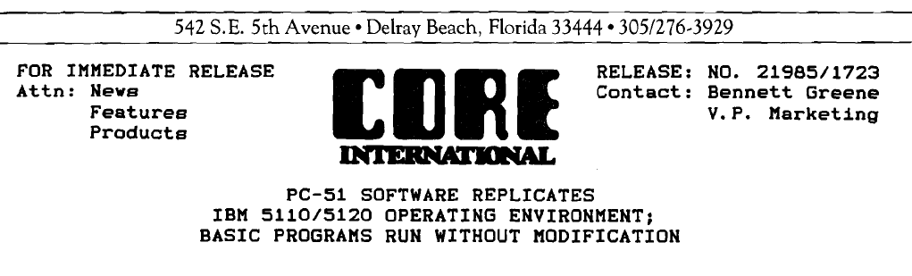
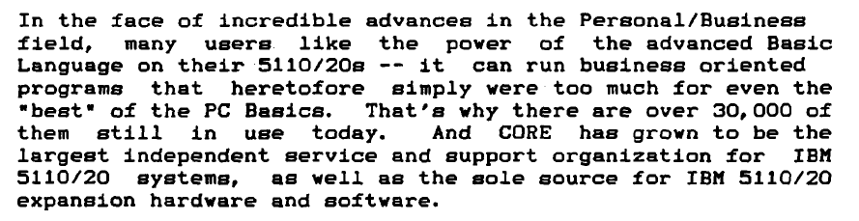
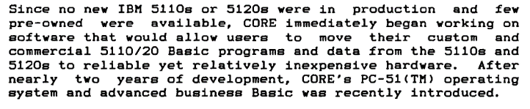
(c. 1982)

Slide 18
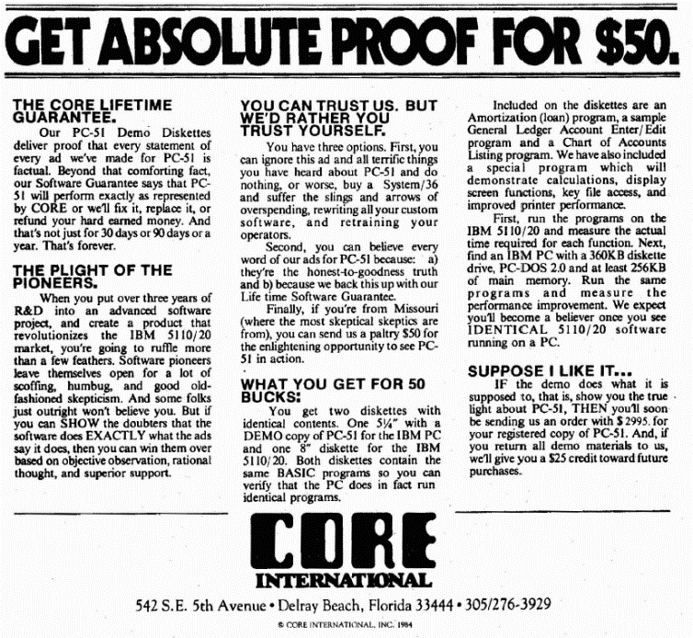
PC-51
(c. 1984)

Slide 19
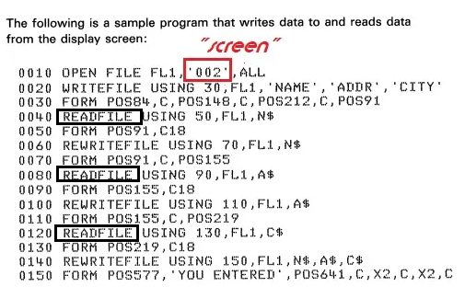
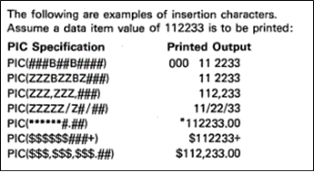
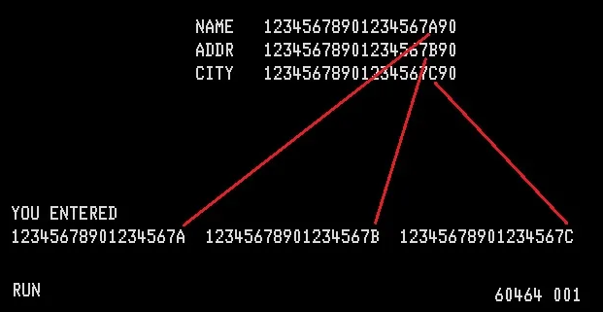
Interesting BASIC Features: FORM
Concept of re-directing from screen to file to printer (“unix”-ish style)

Slide 20
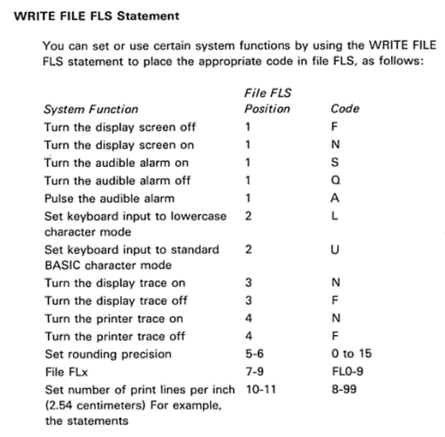
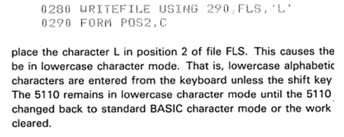
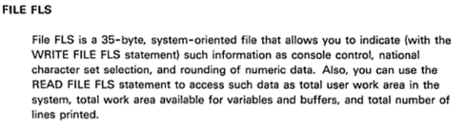
Interesting BASIC Features: FLS
Access special system state using the “FLS” internal file
Early “Windows Registry” file concept?

Slide 21
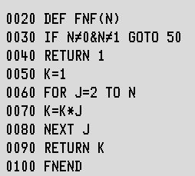
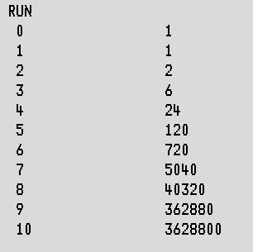
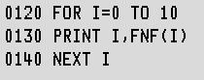
Interesting BASIC Features: FNEND
Multi-line function definitions
Float Point
Exponentials (**)
Trig. functions
MAT functions (no DOT)
CHAIN
AUTO/RENUM
“Function Keys” macros (LOAD0, KEY6)
MERGE
RUN ,P=D
constants (&PI)

Slide 22
Other Lacking BASIC Features
Strings use single quote (‘) instead of double (“)
BASIC MAT (matrix) has many features but is lacking DOT-PRODUCT
(lack of DOT-PRODUCT can make conversion from APL to BASIC difficult)
ELSE of an IF is not supported (S/370 BASIC had all these features)
No single key exclamation (!), must use an “overstrike” sequence
(“overstrike” is using a multi-character input to enter in a normally non-printable single character; same approach used by Asian languages on English keyboards)

Slide 23
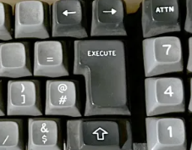
Lacking BASIC Features
x
←
No PEEK/POKE (or SYS/CALL)
This prevents making an INKEY like function to poll for keystrokes
No CLS (clear screen)
The IBM 5100-series is emulating systems that used line printers that didn’t have a screen (CRT) to clear.
If you were sitting at a line printer terminal, the idea of “clearing the screen” wouldn’t mean anything

Slide 24
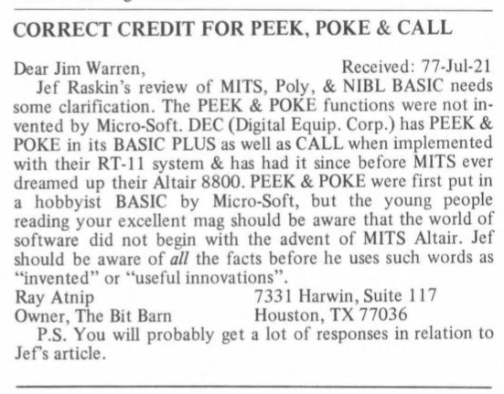
BYTE Magazine “letters to editor” c.July 1977 in response to a prior article

Slide 25
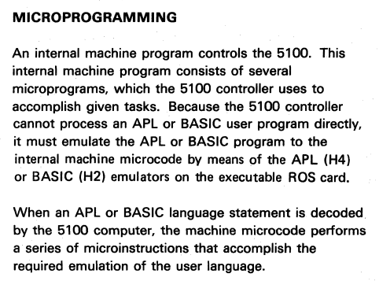

Time to get technical…
Deep Dive!
(from the IBM 5100 Maintenance manual)

Slide 26
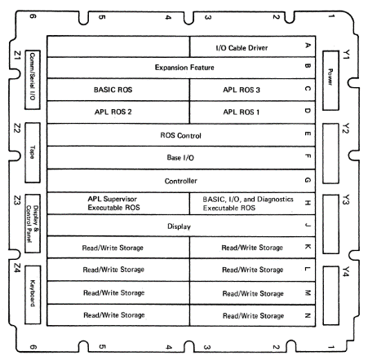
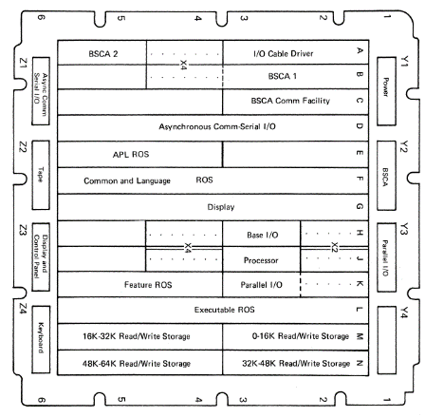
A1 Board Comparison
IBM 5100
IBM 5110
“nx”
54KB
96KB
(18KB)
128KB
“nx”
KBD, TAPE
16KB
72KB
PALM
(APL)
64KB
KBD, TAPE
(BASIC)
PALM
20KB
16KB
32KB

Slide 27
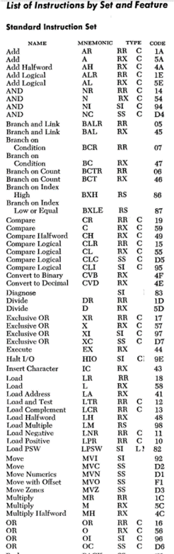
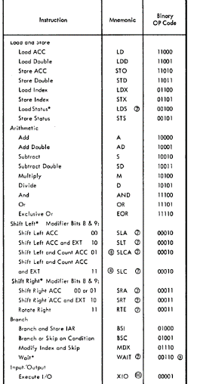
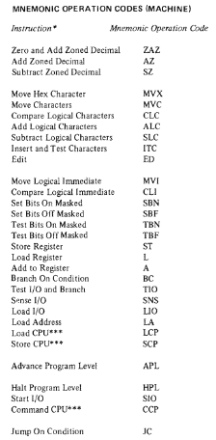
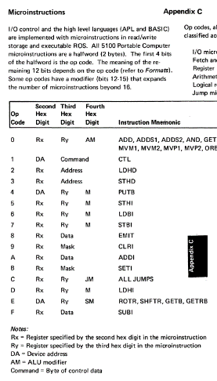
Comparison of Instruction Sets
IBM System/360
IBM 1130
IBM System/3
IBM 5100 (PALM)
(plus over 40 extended codes)

Slide 28
Prototype to Production
SCAMP (1973)
IBM 5100
(1975)
IBM 5110
(1977)
Controller (PALM)
Controller (PALM)
64KB
Executable(PALM)
32KB
APL (IBM 1130)
APL (IBM S360)
96KB
BASIC (IBM S3)
54KB
Common ROS 16KB
ROS Control
The system does provide a way to extract and export the non-executable and support ROS. (as devices)
But how was the Executable ROS itself extracted?
A: By using a special feature of the system startup.
APL ROS (PALM) 20KB
BASIC ROS (PALM) 16KB
APL (IBM S360)
128KB
BASIC (IBM S3)
72KB
The above was discussed by Joey Tuttle (IBM 5100 developer) at VCF in 2003.
“Non-Executable” (NX)

Slide 29
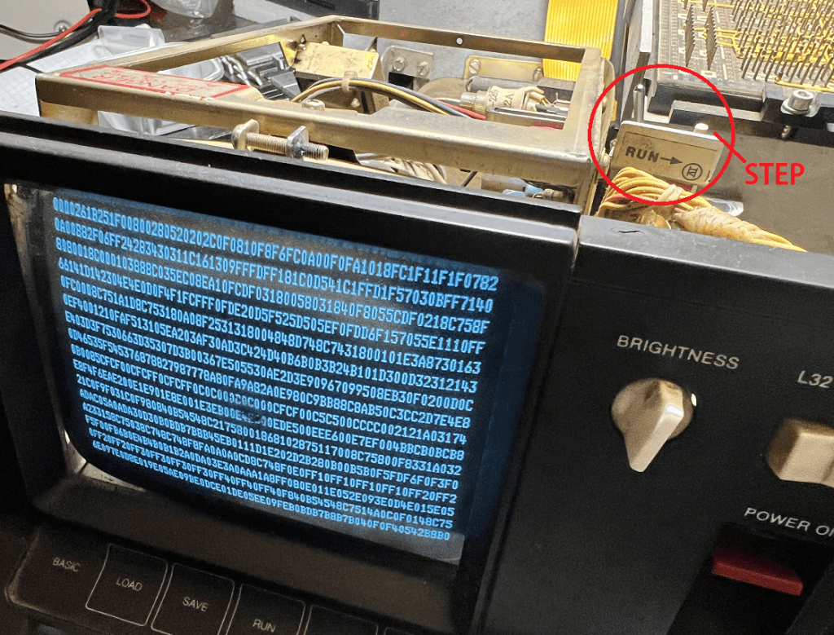
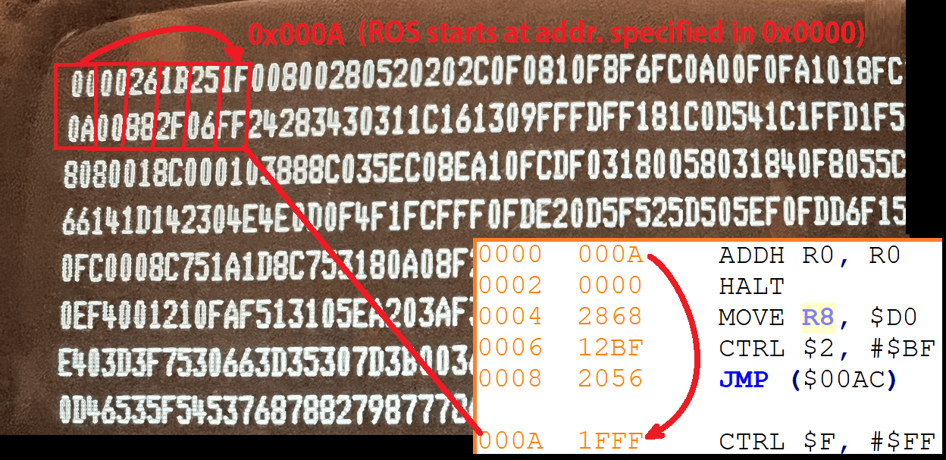
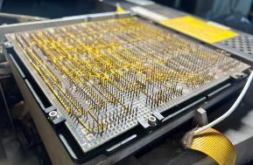
Executable ROS Extraction
Christian Corti determined an approach on the IBM 5110 in c. 2005
Tom Stepleton applied this approach on the IBM 5100 in c. 2019
Pull the address lines to the desired 512 byte address
This is done 128 times (address lines in Logic Diagrams)
128 * 512 = 64KB
Place the system into STEP mode by flipping the RUN switch
Power on the system and take an image of the startup screen while in “Registers Mode” (with hexadecimal)
OCR these images (or type all the values manually!)

Slide 30
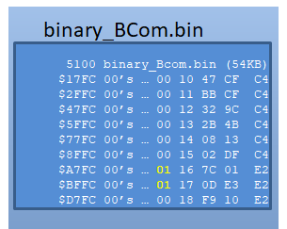




6KB ROS Segments (IBM 5100)
ROS Control
“I” and “O” omitted since they are
often confused with 1 and 0.

Slide 31

6KB ROS Segments (IBM 5110)

Slide 32




The Mysterious “Chapter 2”
Found by C. Corti ~2006 in an IBM Museum archive
(greater detail than Appendix C)
important!
Compare: IBM 5100 MIM Appendix C

Slide 33
The IBM System/360 Relationship: Search for EBCDIC (Extended Binary Coded Decimal Interchange Code )
Search the binary ROS and assume the given values are EBCDIC
Convert the given value to the ASCII equivalent
e.g. EBCDIC index 129 == ASCII symbol ‘a’ (97)
E.g. EBCDIC index 240 == ASCII symbol ‘0’ (48)
Do this only for printable characters and queue up such conversion longer than 3 character (4 or more)
IBM 5100
EXEC ROS 0
BASIC NX/Common 2
APL NX ~8
0x08ccd jklmnpoq
0x08ce6 0000
0x09ef2 jklmnqo
0x0a250 0123456789
0x106f7 jklmnpoq
0x12588 NNNN
0x12a20 jklmn
0x12a91 abcdefghi
0x12b71 abcdefghi
0x12b81 jklmnopqr
0x8967 ABCDEFGHIJKLMNOPQRSTUVWXYZ0123456789
0x89e7 abcdefghijklmnopqr

Slide 34
The IBM System/360 Relationship: Search for EBCDIC (Extended Binary Coded Decimal Interchange Code )
Search the binary ROS and assume the given values are EBCDIC
Convert the given value to the ASCII equivalent
e.g. EBCDIC index 129 == ASCII symbol ‘a’ (97)
E.g. EBCDIC index 240 == ASCII symbol ‘0’ (48)
Do this only for printable characters and queue up such conversion longer than 3 character (4 or more)
IBM 5100
EXEC ROS 0
BASIC NX/Common 2
APL NX ~8
IBM 5110
EXEC ROS 0
BASIC ROS 0
APL ROS 0
Common ROS 319
BASIC NX 60
APL NX 174
PALM

Slide 35
Sample of EBCDIC Strings found in IBM 5110
Common ROS
BASIC NX ROS
APL NX ROS
Hex given values are the corresponding address offset.
0x00c0 HOLD
0x00e0 IBM5100
0x0302 AABBCCDDEEFFGGHHII
0x0c06 DIAG
0x0c10 ADDR
0x0c22 BRANCH
0x0cb4 FILE
0x0d27 ERROR
0x0df4 SORT
0x0e5b COLLATING
0x0fa6 FIELD
0x100f COMPLETED
0x1030 BASIC
0x1150 LOCATION
0x11ce DISK
0x11ee SYSAREA
0x1200 ERRORSET
0x13db AUXILIARY
0x1579 ATTN
0x2e29 ASYNCHRONOUS
0x2e62 BSCA
0x2e7a PARALLEL
0x2e95 MICROPROCESSOR
0x2edb CHART
0x2f39 STATUS
0x039a RUNS PROC GO
0x03c6 ALERT
0x03cc RENUM
0x03d2 AUTO MERGE
0x03dc UTIL REWIND LINK
0x042e FORM
0x0512 CHAIN
0x0536 AIDX (?)
0x053c DIDX (?)
0x0542 DBCRPOS (?)
0x0557 EOF ATTN READY
0x058b NOREC
0x0591 NOKEY
0x0597 DUPKEY
0x05c5 SQR2
0x05df INCM (?)
0x060b RECL (?)
0x0611 NOBLOCK
0x0620 PROTECT
0x0628 FILEID VOLID
0x0634 DROP FREE SORT OFF
0x072e 00112233445566778899
0x0e056 ABCDEFGHIJKLMNOPQRSTUVWXYZ
0x0e08c 0123456789
0x0e0ba abcdefghijklmnopqr
0x10f0a COPYRIGHT
0x10f18 1976
0x12044 ERROREXCEEDED
0x12052 MAXIMUM
0x1205a RECORD
0x13ee0 WS LOADED RESUMED NOT
0x13f1b INCORRECT
0x13f25 COMMAND
0x13f44 LOCKED
0x13f79 SYMBOL
0x13fa1 SUSPENDED
0x13fab FUNCTIONS
0x15af1 CHECKPOINTED CONTINUED
0x15b5f THIS
0x15b6e LOCKED
0x15b7c FOUND
0x15b8d INVALID
0x15b95 DEVICE
0x15bf9 PROTECTED
0x176ea WS FULL
0x17997 VARS
0x17a00 SYSAREA

Slide 36


< 5100
< 5110

Slide 37


IBM System/360 Assembly Example

Slide 38


From IBM 5110 APL “NX” ROS
50 C0 D1 DC Store Source: Reg. C 0D1DC = Target
Offset = 0, Base Register = D, Displacement = $1DC 05 C0 BALR (Branch and Link) Registers C,0 50 F0 D1 D8 Store Source: Reg. F 0D1D8 = Target
Offset = 0, Base Reg. = D, Displacement = $1D8 41 EE 01 A8 Load Address Target: Reg. E
Offset = E, Base 0, Displacement = $1A8 41 60 00 01 Load Address, Target: Reg. 6 58 10 D0 48 Load Reg. 1 0:D:048 = Source address 12 LTR Load and Test (Reg) 11 LNR Load Negative (Reg)

Slide 39

From IBM 5110 APL “NX” ROS
Similar code found in 5100 APL “NX” ROS @ addr. 0

Slide 40

IBM 5110 System/360 OpCode Vector Table Found in APL “NX” ROS address 0x1C800 (these addresses refer back to the APL ROS) (for the 5100, this table is at 0x17E00 in its APL NX; the addresses refer back to the APL Supervisor portion of its Executable ROS) [curious: why does OpCode 0xFF have an address?]
ADDR. 0x1C800 INSTRUCTION OP addr. INSTRUCTION OP addr. INSTRUCTION OP addr. INSTR. OP addr.
Model 67 (BASR)

Slide 41
What about the BASIC side of things?
IBM 5100
(1975)
IBM 5110
(1977)
Controller (PALM)
64KB
Executable(PALM)
32KB
APL (IBM S360)
96KB
BASIC (IBM S3)
54KB
Common ROS 16KB
ROS Control
APL ROS (PALM) 20KB
BASIC ROS (PALM) 16KB
APL (IBM S360)
128KB
BASIC (IBM S3)
72KB
“Non-Executable” (NX)
BASIC: Beginners' All-purpose Symbolic Instruction Code

Slide 42





System/3 Model 6 (c. 1970) aka IBM 5406
IBM 2265 Display Station 64x15 CRT
http://www.ibmsystem3.nl/stories/Jenny_C.html
LED accessible directly by using machine code instruction F0.

Slide 43


Spotted in an IBM System/3 Model 6 “Product Announcement” Brochure
C.E. Equipment
Earliest use of an audio tape cassette for digital data storage?
This is the same Carry Corder used on SCAMP!
https://ed-thelen.org/comp-hist/IBM-ProdAnn/sys3m6.pdf

Slide 44
On the IBM System/3 Model 6… from Glenn Henry (IBMer involved in BASIC dev. on S/3)
“System/3 Model 6 was designed for interactive usage…” (BASIC OS, RPG II, CRT)
“This was probably the worst architecture ever imagined for engineering
and scientific computing”
“this system could do what the Apple II did, only much better (internal fixed disk, 64KB virtual memory, etc.), and 9 years earlier.”
Except: “it weighed 1,300 lbs, it used 220V power, and it rented for about $1,000 a month.”
“In spite of my complaints about the System/3 instruction set, the BASIC system actually performed well.”
http://www.glennsmuseum.com/items/s3m6/

Slide 45

IBM System/3 Assembly Example
ADDR OBJ. CODE
Humans wrote this? Yikes.
http://www.bitsavers.org/pdf/ibm/system3/plm/LY34-0001-1_System3_Model_6_BASIC_Logic_Manual_Jan72.pdf
https://bitsavers.org/pdf/ibm/system3/assembler/SC21-7509-7_System3_Basic_Assembler_Reference_Manual.pdf
http://www.bitsavers.org/pdf/ibm/system3/
GA21-9236-1_IBM_System-3_Model_8_10_12_15_Components_Reference_Manual_Nov77.pdf (page 33 for F0 LED notes)

Slide 46


Using 5110VEMU (PALM emulator)
C8
20
0x0800 + (0xC8 + 0xC8) = 0x0990
Used internal breakpoints in emulator to determine that 0x019A is the “instruction fetch” routine for the BASIC emulation. (on 5110)
0B
2A
05
https://github.com/voidstar78/5110VEMU

Slide 47

The BASIC NX OpCode Vector Table
This is for IBM 5110 @ address 0x0000 (in BASIC NX ROS)
During startup, this table is copied into RWS at 0x0800
The 5100 has a similar convention (just different addresses)

Slide 48

(start of 5110 BASIC NX ROS in support of "10 A=8" BASIC statement)
CardCode Mnem.
0924: C8 20 0B 2A 05 C4 BA8
CA 0F 0B 2A 23 EE D BA8 2
3B 10 0B 6C C 8 21 SBF
38 80 0B A1 04 9F DC 8 TBN
31 00 0B A8 (skipped)
3C 40 05 C0 C 84 MVI
3C 00 0B 57 C 84 MVI
09 01 0B 58 00 00 DCBA8 1
3B 10 0B 6D C 8 21 SBF
3B 08 0B A4 C 8 21 SBF
33 40 01 3F DC 21
3C FF 10 CE C 84 MVI (set RWS[10CE] == FF)
04 40 10 CF 10 CE DCBA 4 ZAZ (copy RWS[10CE] into 10CF++, 320 times)
3B 04 0B 6D C 8 21 SBF
35 40 0B 63 DC 4 1 L
33 50 00 03 DC 21
F8 40 50 8
C0 A0 04 D5 D BC
…
09DE: 33 40 00 05 DC 21
33 10 05 80 DC 21
33 30 05 BF DC 21
F1 05 F4 1 APL
…
0BE8: 34 80 0F D9 DC 4 ST
33 30 05 C0 DC 21
DD 40 00 06 01 D B 84 1
For System/3, not all OpCodes had an assembler mnemonic.
IBM System/3 Component Reference Manual
GA34-0001-3 (Model 6 @ archive.org)
GA21-9236-1(other Models)
Confirmed similar for the IBM 5100, using 0x06B8 as starting point: 06B8: 3B 10 0B 69
3D 0F 0B 1C 10 48 39
38 80 0B 97 06 CD
31 00 0B 9A
3C 00 05 C0
3B 10 0B 6A
09 FF 0F D4 00 FF
09 49 10 D4 00 FF
33 40 00 05
33 10 05 80
33 30 05 BF
F1 08 9C
F0 07 33 ; "7h"
33 20 0F D4
7D 1B 00 18 07 0C
Notes:
http://www.bitsavers.org/pdf/ibm/system3/GA21-9236-1_IBM_System-3_Model_8_10_12_15_Components_Reference_Manual_Nov77.pdf

Slide 49

BASIC Tokens @ 120Eh
As with more modern implementations of BASIC, each line of BASIC is “tokenized” into a byte sequence
A “linked list” (next/prev. pointers) of tokens starts at RWS address 0x120E (just after a long marker of 0xFF’s)
NOTE: The “FF” markers change to “40” after a RUN (garbage collection), then revert back to “FF” after a LIST

Slide 50




P.A.L.M. Assembly Example
ADDR
OBJ. ASM.
Working on preparing a better explanation of PALM assembler (will be in github), but here is a few simple examples.

Slide 51




DCP: Diagnostics Control Program
All IBM 5100’s have a built-in DCP that can be used to modify any memory address
< 5100
undocumented!
This might happen if
you have a stuck key.
5110 >
During ROS CRC checks, you can enter DCP by pressing: CMD-ATTN. However, if you press a key too early, the system shows you the scan code of the key pressed!

Slide 52


IBM 5100/5110 NEWS
Christmas Star 2022 Contest
Sponsored by Logiker (Dec 2, 2022 – Dec 26, 2022)
https://logiker.com/Vintage-Computing-Christmas-Challenge-2022
Output a 17x17 symmetric star in as few bytes as possible
All results at demozoo.org
IBM 5110 APL 3rd place (Peter De Watcher, 30 bytes)
https://demozoo.org/productions/316775/
IBM 5100 BASIC 3rd place WILD (voidstar)
https://demozoo.org/productions/317067/

Slide 53

IBM 5100/5110 NEWS
IBM 5110 SLM (System Logic Manuals) digitized on github (JPG)
https://github.com/voidstar78/IBM5110_SLM
For IBM 5100, these are part of MIM Section 5
JUST IN: Now have complete SLM for 5120 also!
VEMU5110 now has an integrated PALM disassembler
V2 branch in github
Still struggling to fully emulate 5100-system
Still investigating access to external pins
Alfred Arnold Macro AS Assembler now supports PALM
Supports both IBM and Corti-style mnemonics
http://john.ccac.rwth-aachen.de:8000/as/
08FE

Slide 54





IBM 5100/5110 NEWS
“Discovered” use of the IBM 5110 character set
Linear binary sequencing
Unique to the 5110 (?)
Confirmed daisy-chained multiple monitors works!
Superbat 3G/HD SDI Cable BNC Cable
JVC 9in to 14in BNC monitor (plus BNC to VGA adapters)
08F7

Slide 55


IBM 5100/5110 NEWS
Reminders…
Have a serial adapter based on Arduino or ESP32 to stream into the IBM 5100-series keyboard [requires 330ohm resistors]
Notes on github “KBD5110” project
Have an approach to replacing the IBM 5100-series power supply (based on a modern Mean Well PSU)
See notes at:
https://voidstar.blog/ibm-5100-personal-computer/

Slide 56
END.
Thank-you to bitsavers.org & archive.org
Thank-you to Christian Corti
“ASCII” BadApple demo on 5100 when? ;)
64KB in memory-only (few seconds); use 5110 for speaker

Slide 57
Key Takeaways

Slide 58
Key Takeaways
- Per Hal Prewitt, IBM 5100 to 5150 data exchange is possible using only PALM instructions and the external I/O pins
Could a WiModem232 compatible terminal be developed to get the IBM 5100 onto the internet? Could BadApple be streamed to an IBM 5110 display?
- The FORM, USING, PIC keywords gave the IBM 5110 BASIC some interesting features for data entry
- PEEK/POKE predate Microsoft BASIC by several years
- Hardware signals can be manipulated to override the intent of software (re: IBM 5100 Executable ROS extraction process)
- For the IBM 5100, the IBM System/360 OpCode Vector table is at 0x17E00 of the APL NX ROS (0x1C800 for the 5110)
- The use of OpCode 0D suggest the IBM System/360 Model 67 was used
- The Norelco Carry-Corder used in the SCAMP prototype was also used in the IBM System/3 CE equipment
- The IBM 5110 ROS contains an interesting set of plain-English words when converted from EBCDIC to ASCII
- For the IBM 5100 and 5110, the IBM System/3 OpCode Vector table is at 0x0000 of the BASIC NX ROS
- This table is copied to 0x0800 of the RWS during startup
- For the IBM 5110, BASIC tokens are stored at address 0x120E of the RWS
- 5110VEMU is a new front-end to the Christian Corti IBM PALM processor emulator
- An MCU can be used as a keyboard substitute for the IBM 5100/5110/5120
- A replacement to the IBM 5100/5110 power supply is available using modern parts
- Alfred Arnold Macro AS assembler now supports PALM instruction set (which can be input using the built in DCP)
Notes:
Repeat the Key Takeaways slide from the beginning and review what the participant should have learned from your session. Key Takeaways are main points of the presentation audience members would want to understand and be more comfortable with doing.
Key Takeaways are critical for TOI as well as retention of material.
BEST PRACTICES:
Limit Key Takeaways to 3- 5 digestible bullets
Before you show the key takeaway slide, ask the audience what they think the key takeaways are from the presentation

Slide 59
Key Takeaways
Looking for a copy of the CORE PC-51 program for IBM PC-DOS
Looking for any info about the CoreNET hard drive available for IBM 5110/5120
Looking for copies of IBM GB30-xxxx articles
Looking for anyone willing to repair IBM 5110 Power Supply
Looking for any stories from those who used an IBM 5100 or involved in its development
Looking to contact Harry Katzan, Jr (author of IBM 5100 Portable Computer and still actively writing fiction stories as recent as 2019)
Notes:
Repeat the Key Takeaways slide from the beginning and review what the participant should have learned from your session. Key Takeaways are main points of the presentation audience members would want to understand and be more comfortable with doing.
Key Takeaways are critical for TOI as well as retention of material.
BEST PRACTICES:
Limit Key Takeaways to 3- 5 digestible bullets
Before you show the key takeaway slide, ask the audience what they think the key takeaways are from the presentation

Slide 60
Additional Resources

Slide 61
Additional Resources
IBM 5100/5110 Reference Info
https://voidstar.blog/ibm-5100-personal-computer/
https://voidstar.blog/ibm-5110-notes/
https://github.com/voidstar78/IBM_5100_DOCS
https://github.com/voidstar78/IBM5110_SLM
http://computermuseum.informatik.uni-stuttgart.de/dev/ibm_5110/technik/en/
5110VEMU
https://github.com/voidstar78/5110VEMU
KBD5110
https://github.com/voidstar78/KBD5110
Macroassembler AS (Alfred Arnold) [now supports PALM]
http://john.ccac.rwth-aachen.de:8000/as/
IBM 5110 PALM Christmas Tree Demo
https://www.youtube.com/watch?v=2pKpCWdYujA
IBM 5100 Tape Usage Demo
https://www.youtube.com/watch?v=e2GYWyZyfpE
“A Microprocessor-based portable computer: The IBM 5100” (IEEE Volume 64 issue 6, June 1976)
SCAMP and J.D.George related documentation at Smithsonian Institute
https://americanhistory.si.edu/collections/search?return_all=1&edan_local=1&edan_q=1988.3146&

Slide 62

What is Microcode?
“Introduction to Microcoded Implementation of a CPU Architecture”
N.S. Matloff, Jan. 1999
- “How the 8086 processor's microcode engine works”
Ken Shirriff, Dec. 2022
- “The IBM System/360 and the Use of Microcode” – SciHi Blog, April 2022
- “DOWN THE INTEL MICOCODE RABBITHOLE” – HACKADAY, July 2022
"Microcode allows a processor with a small instruction set to function like one with a larger instruction set."
- smoore, 2010 (StackExchange)

Slide 63
Example of IBM 5110 Usage
Publications referenced in… IBM 5110/5120 Computing Systems Bibliography (GH30-0232-1)
GB30-1038 IBM 5110 Bowling League Scoring System
GB30-1180 IBM 5110 Linear Programming Meat Blending System
GB30-1263 IBM 5110 Computing System For Insurance Agents and Brokers
GB30-1126 IBM 5110 Computing System Construction Payroll/Labor Costing
GB30-1268 IBM 5110 Doctors Office Management System
GB30-1034 IBM 5110 Computing System Air Freight Rating Optimization System
GB30-1113 IBM 5110 Computing System General Ledger System
GB30-1242 IBM 5110 Computing System Fixed Asset Accounting and Control System
G360-0638 Viewpoint IBM 5110 A furniture manufacturer, a bank, and a hospital
I have not yet found hard-copies of these articles (GB30-xxxx). But this is evidence to the variety of uses of these systems.

Slide 64


Example of IBM 5110 Users

Slide 65


Example of IBM 5110 Users
A) “The first 5110 was shipped from the GSD's Rochester, Minn., plant on February 2, 1978, to Punxsutawney Electric Repair Company, a small electrical products distributor in Pennsylvania. The customer used the 5110 for billing, inventory control, accounts receivable and sales analysis.”
Contacted Jeff Grube, vice president of Punxsutawney Electric Repair (c. 2021)
Confirmed: “I programmed three of them that our businesses used until pc’s replaced them.”
B) Insurance company in Goldthwaite, TX (5110 Type-2) for General Ledger, Payroll and Accounts Payable for local farms and businesses
C) Electronics components (filters) business in New Jersey (accounting and payroll) [krfilters.com]
D) The IBM 5100 I acquired has matching labels on the main unit and the IBM 5106 tape unit:
La Verendrye General Hospital, Fort Frances, Ontario 0262

Slide 66


Slide 67




Slide 68


Some PALM Processor Technical's
Instruction
Execute

Slide 69


Computerworld Aug. 1980 Benchmark
Not stellar performance by 1980, but…
It was Portable and Well supported.
Unsure if the test disabled CRT (cycle-stealing overhead).
A lot of existing software was available.
Doesn’t reflect the raw processor performance. (PALM)

Slide 70



PML/PMC (Pseudo Machine Language/Code)
(3-227, page 263)
No evidence found that this is used on the IBM 5100-series.
System/3 Model 6 BASIC Logic Manual (Jan ‘72, page 23)

